Slide 1
MONEY MATTERS : PERSONAL FINANCE MANAGEMENT APP
SUBMITTED BY:
ABHI ROOBINI S - 715522243001
DHANUSREE N - 715522243014
HARSHINI T K S - 715522243020
JWANISHA K - 715522243022
-K.SREE SAI SRAVANI
121322033007

Slide 2
DESCRIPTION
Finance Manager Android App: This app simplifies personal finance by tracking income, expenses, and savings goals through a user-friendly interface.
Dashboard: Offers an overview of balance, income, expenses, and budget, with spending categories for easy monitoring.
Transaction Tracker: Logs each transaction with details, providing a clear view of financial inflows and outflows.
Visual Charts: Displays income and expenses by category to help users spot spending trends.
Budget Planner: Allows users to set budgets and track spending limits per category.
Investment Tracker: Centralizes investment monitoring alongside daily expenses.
Cloud Sync: Enables multi-device access with secure backup.
Security: Protected by PIN, biometric lock, and data encryption.

Slide 3
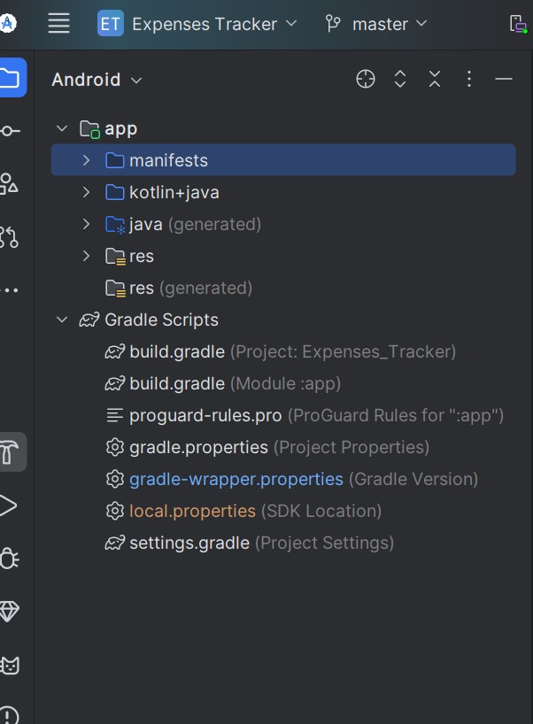
Implementation Finance Management Andriod App Developnment
CODE:

Slide 4
Main Activity.kt:
package com.example.expensetracker
import android.os.Bundle
import androidx.appcompat.app.AppCompatActivity
import androidx.lifecycle.ViewModelProvider
import androidx.recyclerview.widget.LinearLayoutManager
import com.example.expensetracker.databinding.ActivityMainBinding
class MainActivity : AppCompatActivity() {
private lateinit var binding: ActivityMainBinding
private lateinit var expenseViewModel: ExpenseViewModel
override fun onCreate(savedInstanceState: Bundle?) {
super.onCreate(savedInstanceState)
binding = ActivityMainBinding.inflate(layoutInflater)
setContentView(binding.root)
expenseViewModel = ViewModelProvider(this).get(ExpenseViewModel::class.java)
binding.recyclerView.layoutManager = LinearLayoutManager(this)
val adapter = ExpenseAdapter()

Slide 5
binding.recyclerView.adapter = adapter
expenseViewModel.allExpenses.observe(this, { expenses ->
expenses?.let { adapter.submitList(it) }
})
binding.addExpenseButton.setOnClickListener {
val expenseName = binding.expenseNameInput.text.toString()
val amount = binding.expenseAmountInput.text.toString().toDoubleOrNull()
if (amount != null) {
val newExpense = Expense(name = expenseName, amount = amount)
expenseViewModel.insert(newExpense)
clearInputs()
}
}
}
private fun clearInputs() {
binding.expenseNameInput.text.clear()
binding.expenseAmountInput.text.clear()
}
}

Slide 6
Activity_main.xml:
<?xml version="1.0" encoding="utf-8"?>
<LinearLayout
xmlns:android="http://schemas.android.com/apk/res/android"
android:layout_width="match_parent"
android:layout_height="match_parent"
android:orientation="vertical"
android:padding="16dp">
<EditText
android:id="@+id/expenseNameInput"
android:layout_width="match_parent"
android:layout_height="wrap_content"
android:hint="Expense Name"
android:inputType="text" />
<EditText
android:id="@+id/expenseAmountInput"
android:layout_width="match_parent"

Slide 7
android:layout_height="wrap_content"
android:hint="Amount"
android:inputType="numberDecimal" />
<Button
android:id="@+id/addExpenseButton"
android:layout_width="match_parent"
android:layout_height="wrap_content"
android:text="Add Expense" />
<androidx.recyclerview.widget.RecyclerView
android:id="@+id/recyclerView"
android:layout_width="match_parent"
android:layout_height="wrap_content"
android:layout_marginTop="16dp" />
</LinearLayout>

Slide 8

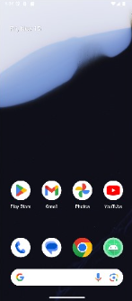
OUTPUT:

Slide 9
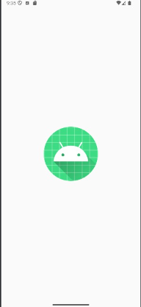
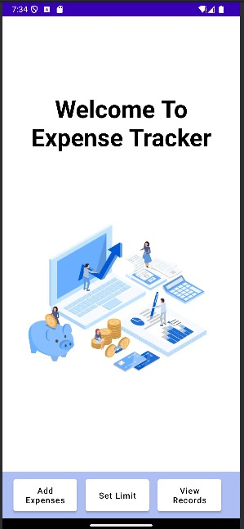

Slide 10
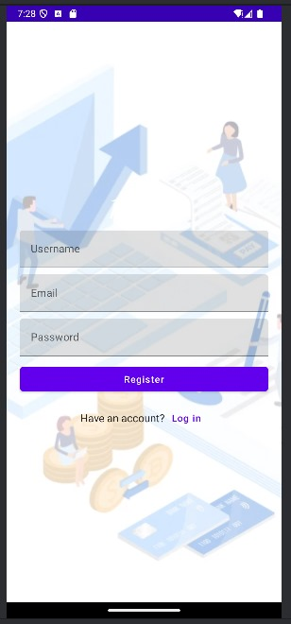
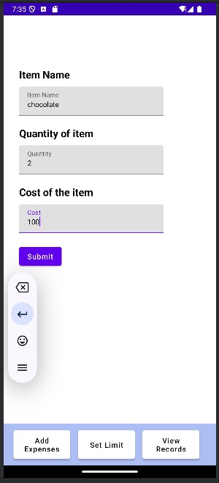

Slide 11
